Slide 1
Lecture 08
Internal Memory

Slide 2
Key points
The two basic forms of semiconductor random access Memory are Dynamic RAM, Static RAM
SRAM is faster more expensive and less dense than DRAM, and is used in cache memory. DRAM is used for main memory.
Error correction techniques are commonly used in memory system.
Advanced DRAM Organization: The two most common are synchronous DRAM and Rambus DRAM.
CH04

Slide 3
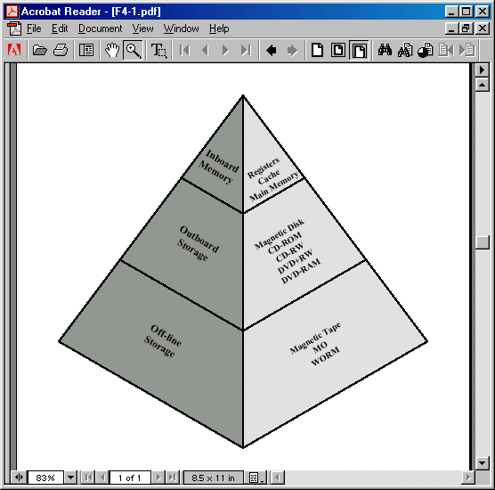
Memory Hierarchy

Slide 4
Location
CPU
Internal
External

Slide 5
Semiconductor Memory
RAM
  Misnamed as all semiconductor memory is random access
  Read/Write
  Volatile
  Temporary storage
  Static RAM or dynamic RAM

Slide 6
Dynamic RAM
Bits stored as charge in capacitors
Charges leak
Need refreshing even when powered
Simpler construction
Smaller per bit
Less expensive
Need refresh circuits
Slower than SRAM
Used for Main memory

Slide 7
Static RAM
Bits stored as on/off switches
No charges to leak
No refreshing needed when powered
More complex construction
Larger per bit
More expensive
Does not need refresh circuits
Faster than DRAM
Used for Cache

Slide 8
Read Only Memory (ROM)
Permanent storage
Microprogramming
Library subroutines
Systems programs (BIOS)
Function tables

Slide 9
Types of ROM
Written during manufacture
  Very expensive for small runs
Programmable (once)
  PROM
  Needs special equipment to program
Read “mostly”
  Erasable Programmable (EPROM)
    Erased by UV
  Electrically Erasable (EEPROM)
    Takes much longer to write than read
  Flash memory
    Erase whole memory electrically like EEPROM. It is intermediate between EPROM and EEPROM. Like EPROM, flash memory uses only one transistor per bit. Flash memory does not provide byte level erasure rather erase blocks of memory.

Slide 10
Organisation in detail
A 16Mbit chip can be organised as 1M of 16 bit words
A bit per chip system has 16 slots of 1Mbit chip with bit 1 of each word in chip 1 and so on
A 16Mbit chip can be organised as a 2048 x 2048 x 4bit array
  Reduces number of address pins
    Multiplex row address and column address
    11 pins to address (2¹¹=2048)
    Adding one more pin doubles range of values so x4 capacity

Slide 11
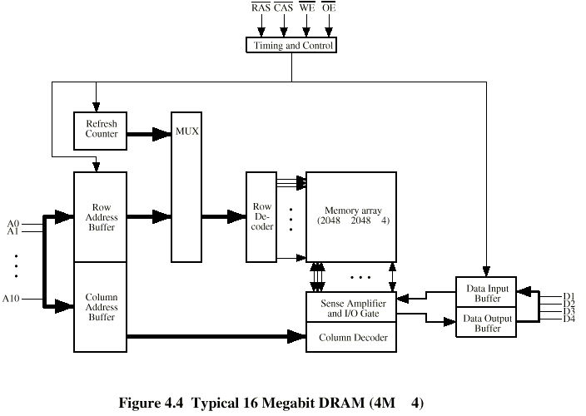
Typical 16 Mb DRAM (4M x 4)

Slide 12
Refreshing
Refresh circuit included on chip
Disable the DRAM chip while all data cells are refreshed.
Refresh Counter steps through all of the rows
The data are readout & Write back into the same location
Takes time
Slows down apparent performance

Slide 13
Packaging
EPROM package (Simple)
  8-Mbit chip organized as 1M x 8.
  20 address pins
  8 pins for data read out
DRAM package
  16-Mbit chip organized as 4M x 4.
  DRAM is accessed row and column and address is multiplexed, only 11 pins are needed to specify $M row/column
  4 pins for data read/write
  RAS to select row and CAS to select column.

Slide 14
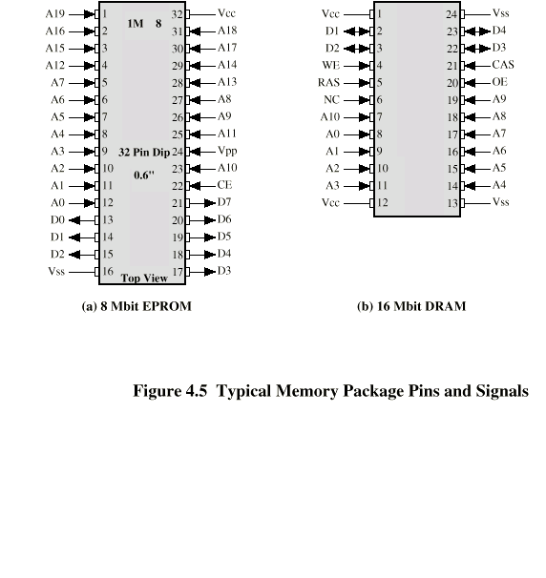
Packaging

Slide 15
Module (256KB)
Organisation
If a RAM chip contains 1 bit per location, then for 256k 8-bit words eight chips is required.
For 256K words, an 18-bit address is needed via address bus
The address is presented to 8 chips of 256 x 1-bit

Slide 16
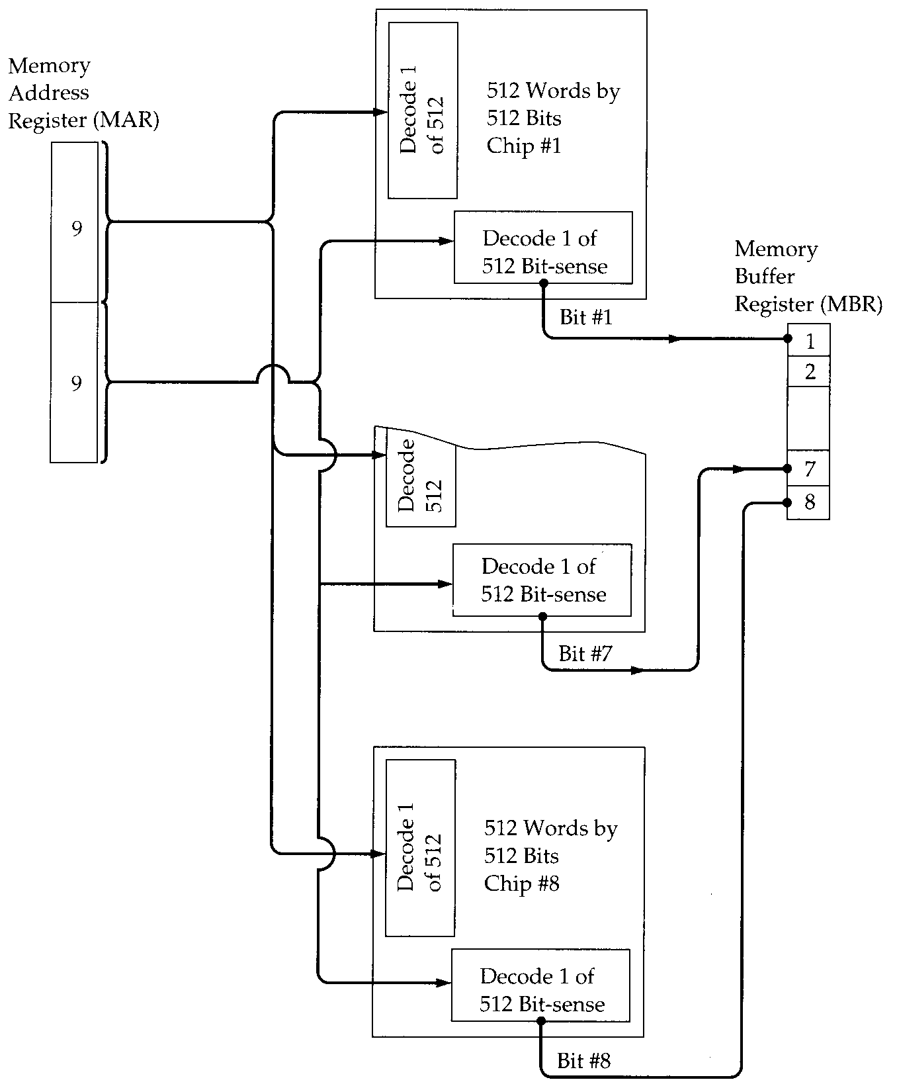
Module (256KB)
Organisation

Slide 17
Memory organization of 1M of 8bit per word
Four column of chips, each column containing 256k words
For 1M word, 20 address lines are needed.
18 least significant bits are routed to all 32(8 x 4) modules. The high order 2 bits are input to select one of the four columns of modules.

Slide 18
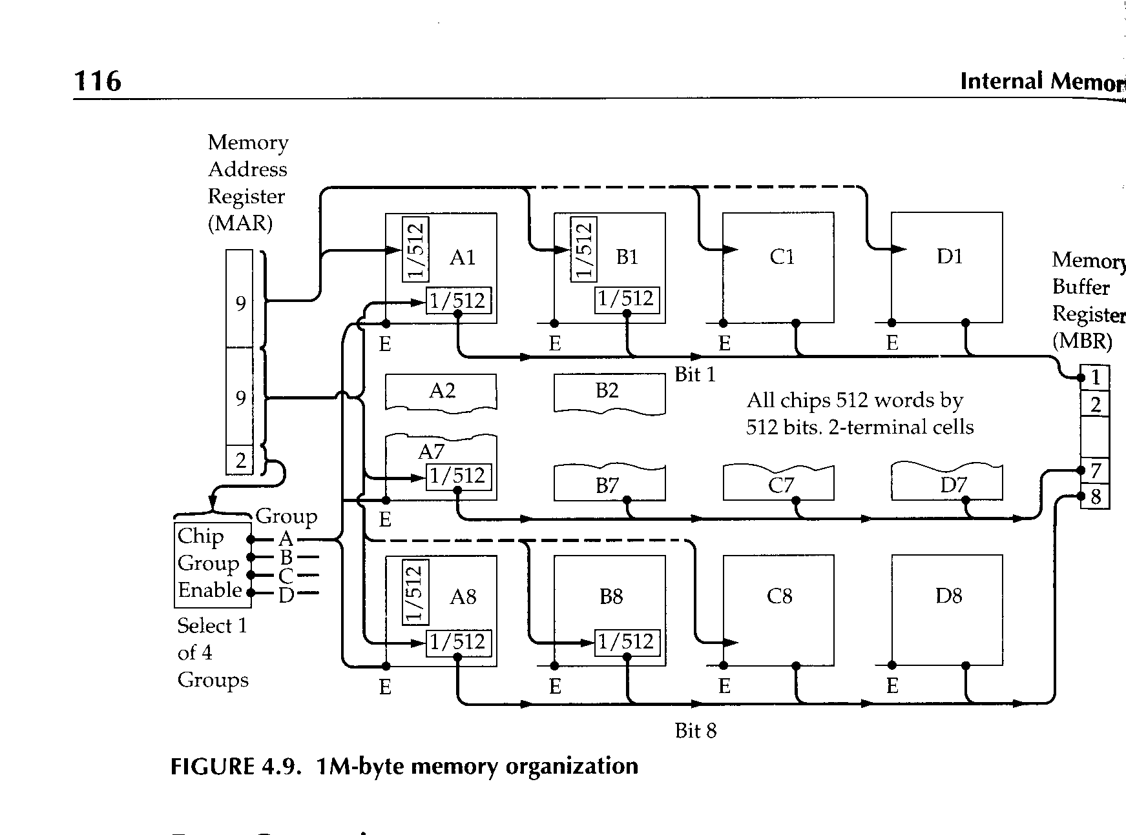
Module Organisation (1MB)

